Slide 1

Chiraq
Notes:
Chiraq is a nickname given to Americas third largest city, Chicago.
Chicago was given this nickname because there are more murders and violence that occur in Chicago than the war in Iraq.

Slide 2

https://anupsatyal.carto.com/builder/a1c86012-23b8-49ad-82cc-f18d3ff565f4/embed

Slide 3
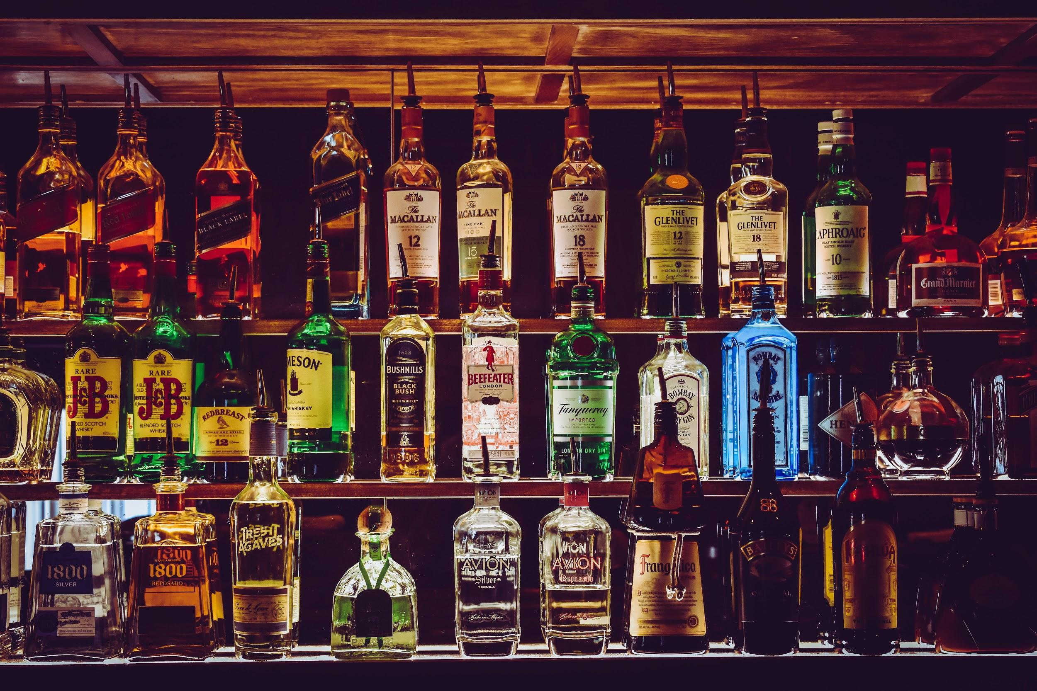
Irish
Whiskey
Sales

Slide 4
Thanks
Group D

Slide 5
Chicago Crime Data Set
Provides historical data for the year 2012 for the reported crime incidents in the city of Chicago (500 crime incidents).
What areas have the most crimes incidents reported?
What are the most common types of crime incidents committed?
In what sublocations are typically crime incidents reported?
Is their enough police support and attention in high crime area?
Are the police arresting the criminals?
How does domestic violence relate to high/low crime rate zones?
Based on the answers of the previous questions we aim to identify:
High criminality areas in which more police effort should be focused

Slide 6
Growth in Irish Whiskey Sales
How many cases of Irish Whiskey?have been sold over the last 16 years?
What are the top 5 countries who have the highest number of cases over the last 16 years?

